Slide 1
Relational Algebra

Slide 2
Introduction
There are two types of query languages:
  Procedural QL
  Non-Procedural QL
Procedural
  What to retrieve and how to retrieve.
  E.g. Relational Algebra
  Results always distinct tuples
  Operations: σ, ∏, ∪, and so on
Non-Procedural
  What to retrieve.
  E.g. Tuple Relational Calculus, SQL
  Tuple relational Calculus: Symbols used in first order logic.
  SQL: select * from table;

Slide 3
Introduction
Relational algebra consists of a set of operations that take one or two relations as input and produce a new relation as their result.
Six basic operators
  select: σ
  project: ∏
  union: ∪
  set difference: –
  Cartesian product: x
  rename: ρ
Derived Operators
  Intersection: ∩
  Join: ⋈
  Divide: /

Slide 4
Introduction
These operations enable a user to specify basic retrieval requests (or queries).
Result of an operation is a new relation, which may have been formed from one or more input relations.
  This property makes the algebra “closed” (all objects in relational algebra are relations).

Slide 5
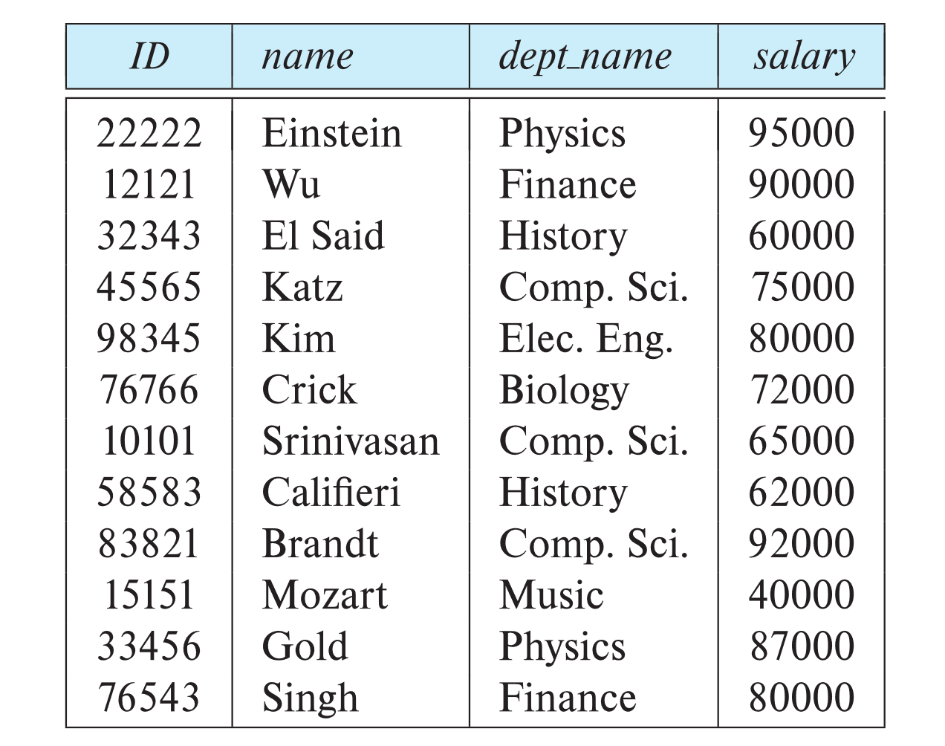
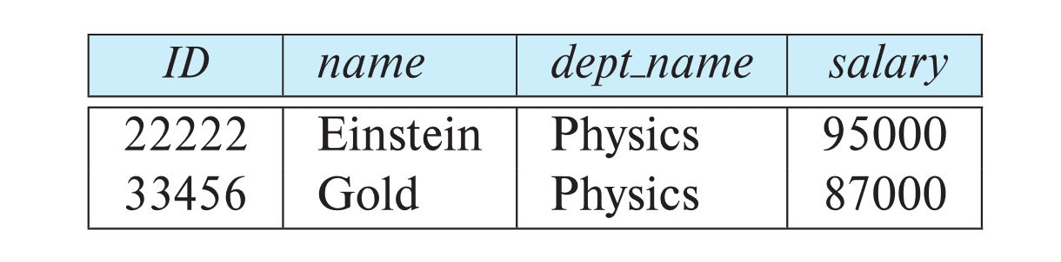

1. Select Operation
select operation selects tuples that satisfy a given predicate.
Notation: σ _{p} (r)
p is called selection predicate (i.e. condition).
Example 1:
Select those tuples of instructor relation where instructor is in “Physics” department
  Query
  σ _{dept_name=“Physics”} (instructor)
  Result
instructor relation

Slide 6
Select Operation
We allow comparisons using
=, ≠, >, ≥. <. ≤
in the selection predicate.
We can combine several predicates into a larger predicate by using connectives:
∧ (and), ∨ (or), ¬ (not)
Example 2: Find the instructors in Physics with a salary greater $90,000, we write:
σ _{dept_name=“Physics”} ∧ _{salary >} _{90,000} (instructor)
select predicate may include comparisons between two attributes.

Slide 7
SELECT Operation Properties
SELECT operation σ _{<selection condition>}(R) produces a relation S that has the same schema (same attributes) as R.
SELECT σ is commutative:
  σ _{<condition1>}(σ _{< condition2>} (R)) = σ _{<condition2>} (σ _{< condition1>} (R))
Because of commutativity property, a cascade (sequence) of SELECT operations may be applied in any order:
  σ_{<cond1>}(σ_{<cond2>} (σ_{<cond3>} (R)) = σ_{<cond2>} (σ_{<cond3>} (σ_{<cond1>} ( R)))

Slide 8
SELECT Operation Properties
A cascade of SELECT operations may be replaced by a single selection with a conjunction of all the conditions:
  σ_{<cond1>}(σ_{< cond2>} (σ_{<cond3>}(R))) = σ <cond1> AND < cond2> AND < cond3>(R)
Number of tuples in the result of a SELECT is less than (or equal to) the number of tuples in the input relation R

Slide 9
2. Project Operation
A unary operation that returns its argument relation, with certain attributes left out.
Notation:
∏ _{A1,A2,A3 ….Ak} (r)
where A₁, A₂, …, A_{k} are attribute names and r is a relation name.
Result is defined as the relation of k columns obtained by erasing columns that are not listed

Slide 10
2. Project Operation
Duplicate rows removed from result, since relations are sets.
  Mathematical sets do not allow duplicate elements.
PROJECT creates a vertical partitioning.
  List of specified columns (attributes) is kept in each tuple.
  Other attributes in each tuple are discarded.

Slide 11
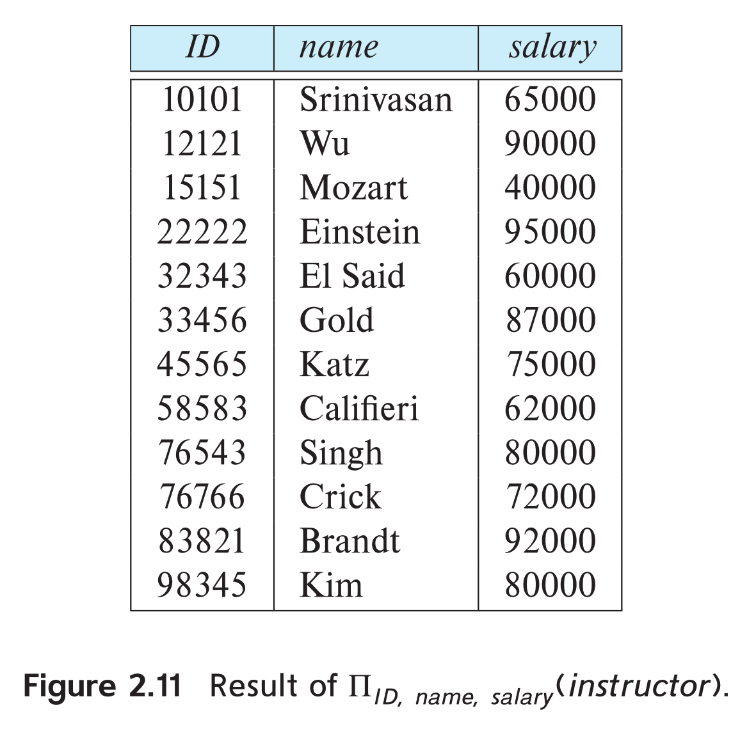
Project Operation
Example 1: eliminate the dept_name attribute of instructor
Query:
∏_{ID, name, salary} (instructor)
Result:

Slide 12
PROJECT Operation Properties
Number of tuples in the result of projection π_{<list>}(R) is always less or equal to the number of tuples in R
  If the list of attributes includes a key of R, then the number of tuples in the result of PROJECT is equal to the number of tuples in R
PROJECT is not commutative

Slide 13
Composition of Relational Operations
Result of a relational-algebra operation is relation and therefore relational-algebra operations can be composed together into a relational-algebra expression.
Example 1- Find the names of all instructors in Physics department.
∏_{name}(σ _{dept_name} _{=“Physics”} (instructor))
Instead of giving the name of a relation as argument of the projection operation, we give an expression that evaluates to a relation.

Slide 14
3. Cartesian-Product Operation
Cartesian-product operation (denoted by X) allows us to combine information from any two relations.
On applying cartesian product on two relations that is on two sets of tuples, it will take every tuple one by one from the left set(relation) and will pair it up with all the tuples in the right set(relation).
So, CROSS PRODUCT of two relation A(R1, R2, R3, …, Rp) with degree p, and B(S1, S2, S3, …, Sn) with degree n, is a relation C(R1, R2, R3, …, Rp, S1, S2, S3, …, Sn) with degree p + n attributes.
A=m tuples
B= n tuples
C= A x B = m x n tuples will be in cross product

Slide 15
Cartesian-Product Operation
Consider two relations STUDENT(SNO, FNAME, LNAME) and DETAIL(ROLLNO, AGE) below:
On applying CROSS PRODUCT on STUDENT and DETAIL:
SNO | FNAME | LNAME
1 | ABC | XYZ
2 | PQR | DEF
ROLLNO | AGE
5 | 18
9 | 21
STUDENT ✕ DETAIL
SNO | FNAME | LNAME | ROLLNO | AGE
1 | ABC | XYZ | 5 | 18
1 | ABC | XYZ | 9 | 21
2 | PQR | DEF | 5 | 18
2 | PQR | DEF | 9 | 21

Slide 16
Cartesian-Product Operation
Cardinality (number of tuples) of resulting relation from a Cross Product operation is equal to number of attributes(say m) in first relation multiplied by number of attributes in second relation(say n).
e.g. as discussed above
When same attribute appear in both relations we distinguish between these attribute by attaching to the attribute the name of the relation from which the attribute originally came.
Cardinality = m*n

Slide 17
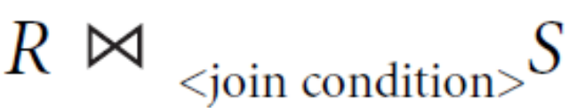
4. Join Operation
Join operation allows us to combine a selection and a Cartesian product into a single operation.
Consider relations r(R) and s(S), and let θ be a predicate on attributes in the schema R ∪ S. The join operation r ⋈_{θ} s is defined as follows:
r ⋈_{θ} s = σ_{θ}(r × s)
The general form of JOIN operation on two relations R(A1, A2, ..., An) and S(B1, B2, ..., Bm) is
Conditional Join is used when we want to join two or more relation based on some conditions. It is also called theta join. Theta join combines tuples from different relations provided they satisfy theta condition.
Theta join can use all kinds of comparison operators {=, <, ≤, >, ≥, ≠}.

Slide 18
Types of JOIN
Inner Joins:
  Theta join
  EQUI join
  Natural join
Outer joins:
  Left Outer Join
  Right Outer Join
  Full Outer Join
Inner Join
  An inner join includes only those tuples with matching attributes and the rest are discarded in the resulting relation.

Slide 19
Theta Join Operation
STUDENT
EMPLOYEE
ROLL_NO | NAME | ADDRESS | PHONE | AGE
1 | RAM | DELHI | 9455123451 | 18
2 | RAMESH | GURGAON | 9652431543 | 18
3 | SUJIT | ROHTAK | 9156253131 | 20
4 | SURESH | DELHI | 9156768971 | 18
EMP_NO | NAME | ADDRESS | PHONE | AGE
1 | RAM | DELHI | 9455123451 | 18
5 | NARESH | HISAR | 9782918192 | 22
6 | SWETA | RANCHI | 9852617621 | 21
4 | SURESH | DELHI | 9156768971 | 18
Select students whose ROLL_NO is greater than EMP_NO of employees
STUDENT⋈ STUDENT.ROLL_NO>EMPLOYEE.EMP_NO EMPLOYEE
In terms of basic operators (cross product and selection) :
σ (STUDENT.ROLL_NO>EMPLOYEE.EMP_NO)(STUDENT×EMPLOYEE)

Slide 20
Cross Validation
ROLL_NO | Student. NAME | Student.ADDRESS | Student. PHONE | Student. AGE
1 | RAM | DELHI | 9455123451 | 18
1 | RAM | DELHI | 9455123451 | 18
1 | RAM | DELHI | 9455123451 | 18
1 | RAM | DELHI | 9455123451 | 18
2 | RAMESH | GURGAON | 9652431543 | 18
2 | RAMESH | GURGAON | 9652431543 | 18
2 | RAMESH | GURGAON | 9652431543 | 18
2 | RAMESH | GURGAON | 9652431543 | 18
3 | SUJIT | ROHTAK | 9156253131 | 20
3 | SUJIT | ROHTAK | 9156253131 | 20
3 | SUJIT | ROHTAK | 9156253131 | 20
3 | SUJIT | ROHTAK | 9156253131 | 20
4 | SURESH | DELHI | 9156768971 | 18
4 | SURESH | DELHI | 9156768971 | 18
4 | SURESH | DELHI | 9156768971 | 18
4 | SURESH | DELHI | 9156768971 | 18
EMP_NO | EMPLOYEE.NAME | EMPLOYEE.ADDRESS | EMPLOYEE.PHONE | EMPLOYEE.AGE
1 | RAM | DELHI | 9455123451 | 18
5 | NARESH | HISAR | 9782918192 | 22
6 | SWETA | RANCHI | 9852617621 | 21
4 | SURESH | DELHI | 9156768971 | 18
1 | RAM | DELHI | 9455123451 | 18
5 | NARESH | HISAR | 9782918192 | 22
6 | SWETA | RANCHI | 9852617621 | 21
4 | SURESH | DELHI | 9156768971 | 18
1 | RAM | DELHI | 9455123451 | 18
5 | NARESH | HISAR | 9782918192 | 22
6 | SWETA | RANCHI | 9852617621 | 21
4 | SURESH | DELHI | 9156768971 | 18
1 | RAM | DELHI | 9455123451 | 18
5 | NARESH | HISAR | 9782918192 | 22
6 | SWETA | RANCHI | 9852617621 | 21
4 | SURESH | DELHI | 9156768971 | 18

Slide 21
Theta Join Operation
RESULT:
ROLL_NO | NAME | ADDRESS | PHONE | AGE | EMP_NO | NAME | ADDRESS | PHONE | AGE
2 | RAMESH | GURGAON | 9652431543 | 18 | 1 | RAM | DELHI | 9455123451 | 18
3 | SUJIT | ROHTAK | 9156253131 | 20 | 1 | RAM | DELHI | 9455123451 | 18
4 | SURESH | DELHI | 9156768971 | 18 | 1 | RAM | DELHI | 9455123451 | 18

Slide 22
Equijoin
Equijoin is a special case of conditional join or theta join where only equality condition holds between a pair of attributes. As values of two attributes will be equal in result of equijoin, only one attribute will be appeared in result.
Example: Select students whose ROLL_NO is equal to EMP_NO of employees
In terms of basic operators (cross product, selection and projection) :
STUDENT⋈STUDENT.ROLL_NO=EMPLOYEE.EMP_NOEMPLOYEE
∏(STUDENT.ROLL_NO, STUDENT.NAME, STUDENT.ADDRESS, STUDENT.PHONE, STUDENT.AGE EMPLOYEE.NAME, EMPLOYEE.ADDRESS, EMPLOYEE.PHONE, EMPLOYEE.AGE)(σ (STUDENT.ROLL_NO=EMPLOYEE.EMP_NO) (STUDENT×EMPLOYEE))

Slide 23
Equijoin
RESULT:
ROLL_NO | NAME | ADDRESS | PHONE | AGE | NAME | ADDRESS | PHONE | AGE
1 | RAM | DELHI | 9455123451 | 18 | RAM | DELHI | 9455123451 | 18
4 | SURESH | DELHI | 9156768971 | 18 | SURESH | DELHI | 9156768971 | 18

Slide 24
Natural Join
It is a special case of equijoin in which equality condition hold on all attributes which have same name in relations R and S (relations on which join operation is applied).
While applying natural join on two relations, there is no need to write equality condition explicitly.
Natural Join will also return the similar attributes only once as their value will be same in resulting relation.
Natural join does not use any comparison operator except =.
We can perform a Natural Join only if there is at least one common attribute that exists between two relations. Common attributes must have the same name and domain.
For NATURAL JOIN operation between two tables R and S, only tuples from R that have matching tuples in S, and vice versa, appear in result.

Slide 25
Natural Join
Example
STUDENT
STUDENT_SPORTS
ROLL_NO | NAME | ADDRESS | PHONE | AGE
1 | RAM | DELHI | 9455123451 | 18
2 | RAMESH | GURGAON | 9652431543 | 18
3 | SUJIT | ROHTAK | 9156253131 | 20
4 | SURESH | DELHI | 9156768971 | 18
ROLL_NO | SPORTS
1 | Badminton
2 | Cricket
2 | Badminton
4 | Badminton
Select students whose ROLL_NO is equal to ROLL_NO of STUDENT_SPORTS as:
STUDENT⋈STUDENT_SPORTS
In terms of basic operators (cross product, selection and projection) :
∏(STUDENT.ROLL_NO, STUDENT.NAME, STUDENT.ADDRESS, STUDENT.PHONE, STUDENT.AGE STUDENT_SPORTS.SPORTS)(σ (STUDENT.ROLL_NO=STUDENT_SPORTS.ROLL_NO) (STUDENT×STUDENT_SPORTS))

Slide 26
Natural Join
RESULT
ROLL_NO | NAME | ADDRESS | PHONE | AGE | SPORTS
1 | RAM | DELHI | 9455123451 | 18 | Badminton
2 | RAMESH | GURGAON | 9652431543 | 18 | Cricket
2 | RAMESH | GURGAON | 9652431543 | 18 | Badminton
4 | SURESH | DELHI | 9156768971 | 18 | Badminton

Slide 27
Outer Joins
When applying join on two relations R and S, some tuples of R or S does not appear in result set which does not satisfy the join conditions.
The outer join operation is an extension of the join operation. It is used to deal with missing information.
In outer join, along with tuples that satisfy the matching criteria, we also include some or all tuples that do not match the criteria.
We need to use outer joins to include all the tuples from the participating relations in the resulting relation.

Slide 28
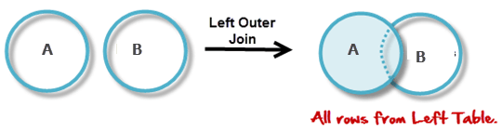
Left outer join
Operation allows keeping all tuple in the left relation.
If there is no matching tuple is found in right relation, then attributes of right relation in join result are filled with null values.
All tuples from the Left relation A are included in the resulting relation.
If there are tuples in A without any matching tuple in the Right relation B, then B-attributes of the resulting relation are made NULL.
Notation: A B

Slide 29
Left outer join
Example
Select students whose ROLL_NO is greater than EMP_NO of employees and details of other students as well
EMPLOYEE
STUDENT
ROLL_NO | NAME | ADDRESS | PHONE | AGE
1 | RAM | DELHI | 9455123451 | 18
2 | RAMESH | GURGAON | 9652431543 | 18
3 | SUJIT | ROHTAK | 9156253131 | 20
4 | SURESH | DELHI | 9156768971 | 18
EMP_NO | NAME | ADDRESS | PHONE | AGE
1 | RAM | DELHI | 9455123451 | 18
5 | NARESH | HISAR | 9782918192 | 22
6 | SWETA | RANCHI | 9852617621 | 21
4 | SURESH | DELHI | 9156768971 | 18
STUDENT STUDENT.ROLL_NO>EMPLOYEE.EMP_NOEMPLOYEE

Slide 30
Left outer join
Result
ROLL_NO | NAME | ADDRESS | PHONE | AGE | EMP_NO | NAME | ADDRESS | PHONE | AGE
2 | RAMESH | GURGAON | 9652431543 | 18 | 1 | RAM | DELHI | 9455123451 | 18
3 | SUJIT | ROHTAK | 9156253131 | 20 | 1 | RAM | DELHI | 9455123451 | 18
4 | SURESH | DELHI | 9156768971 | 18 | 1 | RAM | DELHI | 9455123451 | 18
1 | RAM | DELHI | 9455123451 | 18 | NULL | NULL | NULL | NULL | NULL

Slide 31
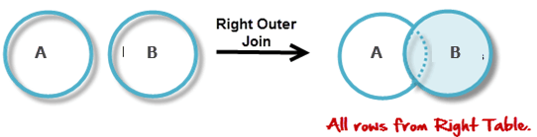
Right Outer Join
Operation allows keeping all tuple in the right relation.
If there is no matching tuple is found in the left relation, then attributes of left relation in join result are filled with null values.
If we are applying right outer join on two relations A and B, it gives all tuples of B in the result set.
If there are tuples in B without any matching tuple in A, then A-attributes of resulting relation are made NULL.
Notation: A B
⟖

Slide 32
Right Outer Join
Example
Select students whose ROLL_NO is greater than EMP_NO of employees and details of other Employees as well.
STUDENT
EMPLOYEE
ROLL_NO | NAME | ADDRESS | PHONE | AGE
1 | RAM | DELHI | 9455123451 | 18
2 | RAMESH | GURGAON | 9652431543 | 18
3 | SUJIT | ROHTAK | 9156253131 | 20
4 | SURESH | DELHI | 9156768971 | 18
EMP_NO | NAME | ADDRESS | PHONE | AGE
1 | RAM | DELHI | 9455123451 | 18
5 | NARESH | HISAR | 9782918192 | 22
6 | SWETA | RANCHI | 9852617621 | 21
4 | SURESH | DELHI | 9156768971 | 18
STUDENT⟖STUDENT.ROLL_NO>EMPLOYEE.EMP_NOEMPLOYEE

Slide 33
Right Outer Join
Result
ROLL_NO | NAME | ADDRESS | PHONE | AGE | EMP_NO | NAME | ADDRESS | PHONE | AGE
2 | RAMESH | GURGAON | 9652431543 | 18 | 1 | RAM | DELHI | 9455123451 | 18
3 | SUJIT | ROHTAK | 9156253131 | 20 | 1 | RAM | DELHI | 9455123451 | 18
4 | SURESH | DELHI | 9156768971 | 18 | 1 | RAM | DELHI | 9455123451 | 18
NULL | NULL | NULL | NULL | NULL | 5 | NARESH | HISAR | 9782918192 | 22
NULL | NULL | NULL | NULL | NULL | 6 | SWETA | RANCHI | 9852617621 | 21
NULL | NULL | NULL | NULL | NULL | 4 | SURESH | DELHI | 9156768971 | 18

Slide 34
Full Outer Join
All tuples from both relations are included in the result, irrespective of the matching condition.
When applying full outer join on two relations R and S, it gives all tuples of S and all tuples of R in the result set. The tuples of S which do not satisfy join condition will have values as NULL for attributes of R and vice versa.
Notation: R S
⟗

Slide 35
Full Outer Join
Example
Select students whose ROLL_NO is greater than EMP_NO of employees and details of other Employees as well and other Students
STUDENT
EMPLOYEE
ROLL_NO | NAME | ADDRESS | PHONE | AGE
1 | RAM | DELHI | 9455123451 | 18
2 | RAMESH | GURGAON | 9652431543 | 18
3 | SUJIT | ROHTAK | 9156253131 | 20
4 | SURESH | DELHI | 9156768971 | 18
EMP_NO | NAME | ADDRESS | PHONE | AGE
1 | RAM | DELHI | 9455123451 | 18
5 | NARESH | HISAR | 9782918192 | 22
6 | SWETA | RANCHI | 9852617621 | 21
4 | SURESH | DELHI | 9156768971 | 18
STUDENT⟗STUDENT.ROLL_NO>EMPLOYEE.EMP_NOEMPLOYEE

Slide 36
Full Outer Join
Result
ROLL_NO | NAME | ADDRESS | PHONE | AGE | EMP_NO | NAME | ADDRESS | PHONE | AGE
2 | RAMESH | GURGAON | 9652431543 | 18 | 1 | RAM | DELHI | 9455123451 | 18
3 | SUJIT | ROHTAK | 9156253131 | 20 | 1 | RAM | DELHI | 9455123451 | 18
4 | SURESH | DELHI | 9156768971 | 18 | 1 | RAM | DELHI | 9455123451 | 18
NULL | NULL | NULL | NULL | NULL | 5 | NARESH | HISAR | 9782918192 | 22
NULL | NULL | NULL | NULL | NULL | 6 | SWETA | RANCHI | 9852617621 | 21
NULL | NULL | NULL | NULL | NULL | 4 | SURESH | DELHI | 9156768971 | 18
1 | RAM | DELHI | 9455123451 | 18 | NULL | NULL | NULL | NULL | NULL

Slide 37
5. Rename Operation
RENAME operator is denoted by ρ (rho)
In some cases, we may want to rename the attributes of a relation or the relation name or both
  Useful when a query requires multiple operations

Slide 38
Rename Operation
General RENAME operation ρ can be expressed by any of the following forms:
  ρ_{S}(R) changes:
    the relation name only to S
  ρ_{(B1, B2, …, Bn )}(R) changes:
    the column (attribute) names only to B1, B1, …..Bn.
    In Relation R, attributes are A1,A2,…..An, So for each Ai is renamed to Bi.
  ρ_{S (B1, B2, …, Bn )}(R) changes both:
    the relation name to S, and
    the column (attribute) names to B1, B1, …..Bn
If we write:
  RESULT ← π _{FNAME, LNAME, SALARY} (R)
    RESULT will have the same attribute names as R.

Slide 39
6. UNION
Set Operators: union, intersection, difference.
Binary operation, denoted by ∪
Result of R ∪ S, is a relation that includes all tuples that are either in R or in S or in both R and S.
Duplicate tuples are eliminated.
Two operand relations R and S must be “type compatible” (or UNION compatible)
  R and S must have same number of attributes.
  Each pair of corresponding attributes must be type compatible (have same or compatible domains).
Resulting relation for R1∪R2 has same attribute names as first operand relation R1 (by convention).

Slide 40
6. UNION
For example :
  R ( Sid , Sname ) and S ( Sid , Sname , Marks ) are not UNION COMPATIBLE, as R has 2 attributes while S has 3 attributes.
  R ( Sid , Sname ) and S ( Sid , Marks ) are not UNION COMPATIBLE, as domain of name and marks is different. Domain of names would be certain strings while domain of marks would be integer and float numbers.
  R ( Sid , Sname ) and S ( Sid , StudentName ) are UNION COMPATIBLE, as R and S both have 2 attributes and their domains are also same, only the column names are different.

Slide 41
UNION
Example
EMPLOYEE
STUDENT
EMP_NO | NAME | ADDRESS | PHONE | AGE
1 | RAM | DELHI | 9455123451 | 18
5 | NARESH | HISAR | 9782918192 | 22
6 | SWETA | RANCHI | 9852617621 | 21
4 | SURESH | DELHI | 9156768971 | 18
ROLL_NO | NAME | ADDRESS | PHONE | AGE
1 | RAM | DELHI | 9455123451 | 18
2 | RAMESH | GURGAON | 9652431543 | 18
3 | SUJIT | ROHTAK | 9156253131 | 20
4 | SURESH | DELHI | 9156768971 | 18
Find person who are either student or employee or both:
ROLL_NO | NAME | ADDRESS | PHONE | AGE
1 | RAM | DELHI | 9455123451 | 18
2 | RAMESH | GURGAON | 9652431543 | 18
3 | SUJIT | ROHTAK | 9156253131 | 20
4 | SURESH | DELHI | 9156768971 | 18
5 | NARESH | HISAR | 9782918192 | 22
6 | SWETA | RANCHI | 9852617621 | 21
STUDENT U EMPLOYEE

Slide 42
7. INTERSECTION
Set-intersection operation allows us to find tuples that are in both the input relations.
INTERSECTION is denoted by ∩
Result of the operation R ∩ S, is a relation that includes all tuples that are in both R and S.
  Attribute names in the result will be same as the attribute names in R.
Two operand relations R and S must be “type compatible”.

Slide 43
INTERSECTION
Example
DEPOSITOR
BORROWER
CUSTOMER_NAME | ACCOUNT_NO
Johnson | A-101
Smith | A-121
Mayes | A-321
Turner | A-176
Johnson | A-273
Jones | A-472
Lindsay | A-284
CUSTOMER_NAME | LOAN_NO
Jones | L-17
Smith | L-23
Hayes | L-15
Jackson | L-14
Curry | L-93
Smith | L-11
CUSTOMER_NAME
Smith
Jones
Find the customers who are both depositor and borrower:
∏ CUSTOMER_NAME (BORROWER) ∩ ∏ CUSTOMER_NAME (DEPOSITOR)

Slide 44
8. SET DIFFERENCE
The set-difference operation allows us to find tuples that are in one relation but are not in another.
SET DIFFERENCE (also called MINUS or EXCEPT) is denoted by –
Result of R – S, is a relation that includes all tuples that are in R but not in S.
  Attribute names in the result will be the same as the attribute names in R
Two operand relations R and S must be “type compatible”.

Slide 45
SET DIFFERENCE
Example
EMPLOYEE
STUDENT
EMP_NO | NAME | ADDRESS | PHONE | AGE
1 | RAM | DELHI | 9455123451 | 18
5 | NARESH | HISAR | 9782918192 | 22
6 | SWETA | RANCHI | 9852617621 | 21
4 | SURESH | DELHI | 9156768971 | 18
ROLL_NO | NAME | ADDRESS | PHONE | AGE
1 | RAM | DELHI | 9455123451 | 18
2 | RAMESH | GURGAON | 9652431543 | 18
3 | SUJIT | ROHTAK | 9156253131 | 20
4 | SURESH | DELHI | 9156768971 | 18
Find person who are student but not employee:
STUDENT - EMPLOYEE
ROLL_NO | NAME | ADDRESS | PHONE | AGE
2 | RAMESH | GURGAON | 9652431543 | 18
3 | SUJIT | ROHTAK | 9156253131 | 20

Slide 46
9. ALL
Union/Union all
Intersect/Intersect all
Minus/Minus all

Slide 47
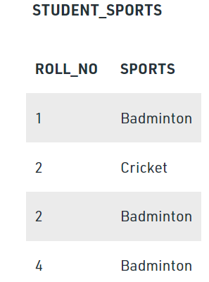
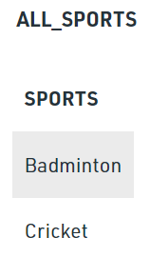
Division Operator
The division operator is used for queries which involve the ‘all’.
Division operator A÷B can be applied if and only if:
  Attributes of B is proper subset of Attributes of A.
  The relation returned by division operator will have attributes = (All attributes of A – All Attributes of B)
  The relation returned by division operator will return those tuples from relation A which are associated to every B’s tuple.
STUDENT_SPORTS ÷ ALL_SPORTS

Slide 48
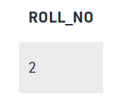
Division Operator
The operation is valid as attributes in ALL_SPORTS is a proper subset of attributes in STUDENT_SPORTS.
The attributes in resulting relation will have attributes {ROLL_NO,SPORTS}-{SPORTS}=ROLL_NO
The tuples in resulting relation will have those ROLL_NO which are associated with all B’s tuple {Badminton, Cricket}. ROLL_NO 1 and 4 are associated to Badminton only. ROLL_NO 2 is associated to all tuples of B. So the resulting relation will be:
Output
STUDENT_SPORTS ÷ ALL_SPORTS

Slide 49
